Slide 1


SIDDAGANGA INSTITUTE OF TECHNOLOGY Department of computer science engineering
‘‘DEEPFAKE DETECTION: SAFEGUARDING TRUTH IN DIGITAL CONTENT”
Batch ID: AD20
By:
INDRAJITH SOMAIAH R M 1SI21AD062
RITHESH D J 1SI21AD060
ANOOP R N 1SI22AD400
Under the guidance of:
Dr. SAHANA L R _{M.Tech,PhD}
Assistant professor

Slide 2
Agenda
High Level Design
Introduction
07
01
Tools and Platforms
Motivation
08
02
Implementation
Literature Survey
09
03
Results
Problem Statement
10
04
System Analysis
Conclusion
05
11
System Architecture
References
06
12

Slide 3

Introduction
Our project aims to develop a cutting-edge system for detecting deep fake videos by leveraging the powerful capabilities of Long Short-Term Memory (LSTM) networks and the ResNext architecture. Deep fake videos, which are synthetic media where a person in an existing image or video is replaced with someone else's likeness, have become increasingly sophisticated and challenging to detect. The widespread use of deep fake technology poses significant threats to privacy, security, and the integrity of information.
This project utilizes a high-level deep learning framework, to build an advanced deep fake video detection system. We employ the pre-trained ResNet50 model, renowned for its ability to extract features from images, combined with LSTM networks,for analyzing sequential data. By integrating these two powerful models, we aim to develop a robust system.

Slide 4
Can we detect Deep fakes with naked eyes?

Slide 5
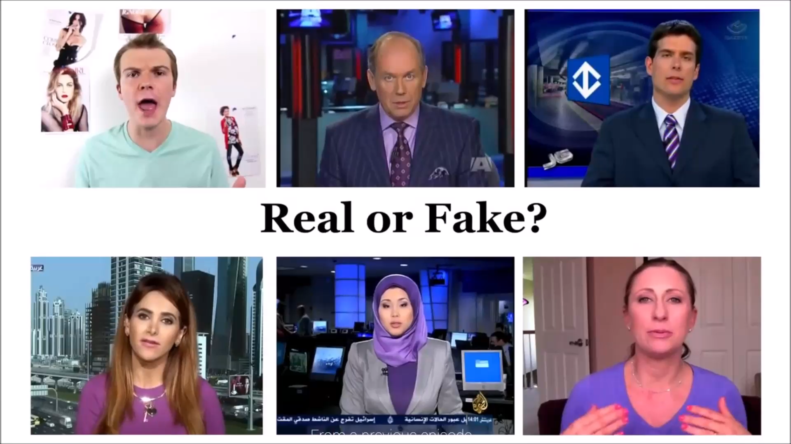

Slide 6
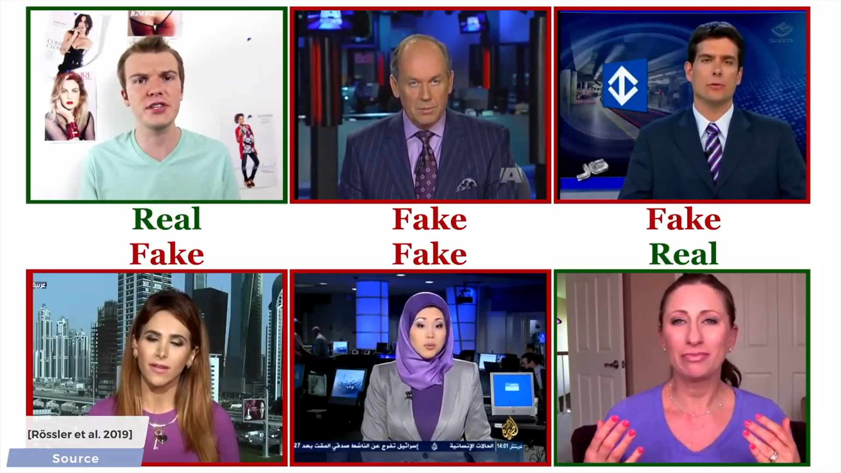

Slide 7
MOTIVATION
Proliferation of Deepfake Content.
Risks to Digital Information Integrity.
Trust in Online Content.
Recognition of Deepfakes' Potency.
Impact on Society.

Slide 8
Literature Survey
SL NO | Title of the article | Reference No | Published Year | Author,Published by | Abstract | Inference
1 | Deepfake Video Detection Using Convolutional Neural Network | 1 | 2020 | Aarti Karandikar, Vedita Deshpande, Sanjana Singh | This paper proposes a deep learning model for detecting deepfake videos by analyzing frames to identify inconsistencies in facial features, compression rates, and introduced discrepancies. Leveraging convolutional neural networks and transfer learning, the model is trained on a dataset specifically curated for deepfake forensics, enabling accurate detection of manipulated content. | Deepfake videos, a product of sophisticated AI, present significant societal risks, requiring detection methods. The proposed solution utilizes deep learning to analyze video frames, identifying inconsistencies and leveraging CNNs trained on datasets like "Celeb-DF" for improved detection accuracy.

Slide 9
2 | Detecting Deepfakes Without Seeing Any | 2 | 2023 | Tal Reiss Bar Cavia YedidHoshen. | Deepfake attacks involve false claims about identity or actions, making traditional detection methods ineffective against new attacks. FACTOR, a fact-checking approach, compares these claims with observed media, requiring no prior training and achieving superior accuracy. | FACTOR's fact-checking approach effectively detects deepfakes by comparing claimed facts with the actual media, overcoming the limitations of traditional methods against new attack types. This technique requires no prior training and achieves higher accuracy, offering a robust solution for identifying deepfake content.
3 | A novel approach for detecting deep fake videos using graph neural network | 3 | 2024 | M. M. El‑gayar, Mohamed Abouhawwash, S. S. Askar And Sara Sweidan. | Deep fake technology poses significant social and security risks, necessitating advanced detection techniques as traditional methods lag behind. This paper introduces an enhanced deep fake detection approach using graph neural networks (GNN), combining a graph convolution network stream and a four-block CNN | Deep fake technology presents significant challenges, requiring advanced detection methods beyond traditional techniques. This paper's proposed approach using graph neural networks (GNN) and a CNN stream demonstrates high accuracy in detecting deep fakes.

Slide 10
 |  |  |  |  | stream. The method, evaluated on various datasets, achieved 99.3% training and validation accuracy after 30 epochs, utilizing three fusion networks: FuNet A, FuNet M, and FuNet C. | The model's success highlights the potential of sophisticated neural network architectures in addressing deep fake detection.
4 | DeepFake Detection for Human Face Images and Videos: A Survey | 4 | 2022 | Asad Malik, Minrou Kuribayashi, Ahamad Neyaz Khan, Sani M. Abdullahi. | DeepFake technology creates highly realistic manipulated multimedia, posing challenges in distinguishing real from fake content. While it has beneficial applications in TV, video games, and cinema, it also enables criminal activities like generating misinformation. Consequently, research in DeepFake detection using deep neural networks (DNNs) has gained significant interest. | DeepFake technology offers impressive multimedia manipulation but poses serious threats, including misinformation. Current deep neural network-based detection methods need improvement in generalization and transferability. Experts emphasize the need for enhanced detection techniques and robust protection methods to counter future AI-driven DeepFake challenges.

Slide 11
PROBLEM STATEMENT
Convincing manipulations of digital images and videos have been demonstrated for several decades through the use of visual effects, recent advances in deep learning have led to a dramatic increase in the realism of fake content and the accessibility in which it can be created. These so-called AI-synthesized media (popularly referred to as deep fakes).Creating the Deep Fakes using the Artificially intelligent tools are simple task. But, when it comes to detection of these Deep Fakes, it is major challenge. Already in the history there are many examples where the deepfakes are used as powerful way to create political tension[14], fake terrorism events, revenge porn, blackmail peoples etc.So it becomes very important to detect these deepfake and avoid the percolation of deepfake through social media platforms. We have taken a step forward in detecting the deep fakes using LSTM based artificial Neural network.

Slide 12
OBJECTIVE
1.Understand machine learning and deep learning techniques for image processing.
2.Our project will reduce the misleading of the common people.
3.Explore neural network architectures (RNN, LSTM) for capturing temporal dependencies.
4.Our project employs proactive measures, aiming to flag such contents for further review or removal.
5.Provide a easy to use system to upload the video and distinguish real or fake.

Slide 13
SYSTEM ANALYSIS:
Existing System Lacks comprehensive system for person recognition. Traditional methods not suitable for all scenarios, Ear biometrics offer unique advantages but lack accuracy and robustness
Proposed System The outcome of our solution is a suite of trained deepfake detection models capable of accurately discerning between authentic and manipulated videos
System Components Feature Extraction Module (ResNet),Temporal Analysis Module (LSTM):Analyzes temporal inconsistencies in video sequences with LSTM networks. Real-Time Processing Engine: Integrates feature extraction and analysis for real-time deep fake detection.
System Benefits our proposed system aims to safeguard against the spread of misinformation and protect the integrity of digital content shared online

Slide 14
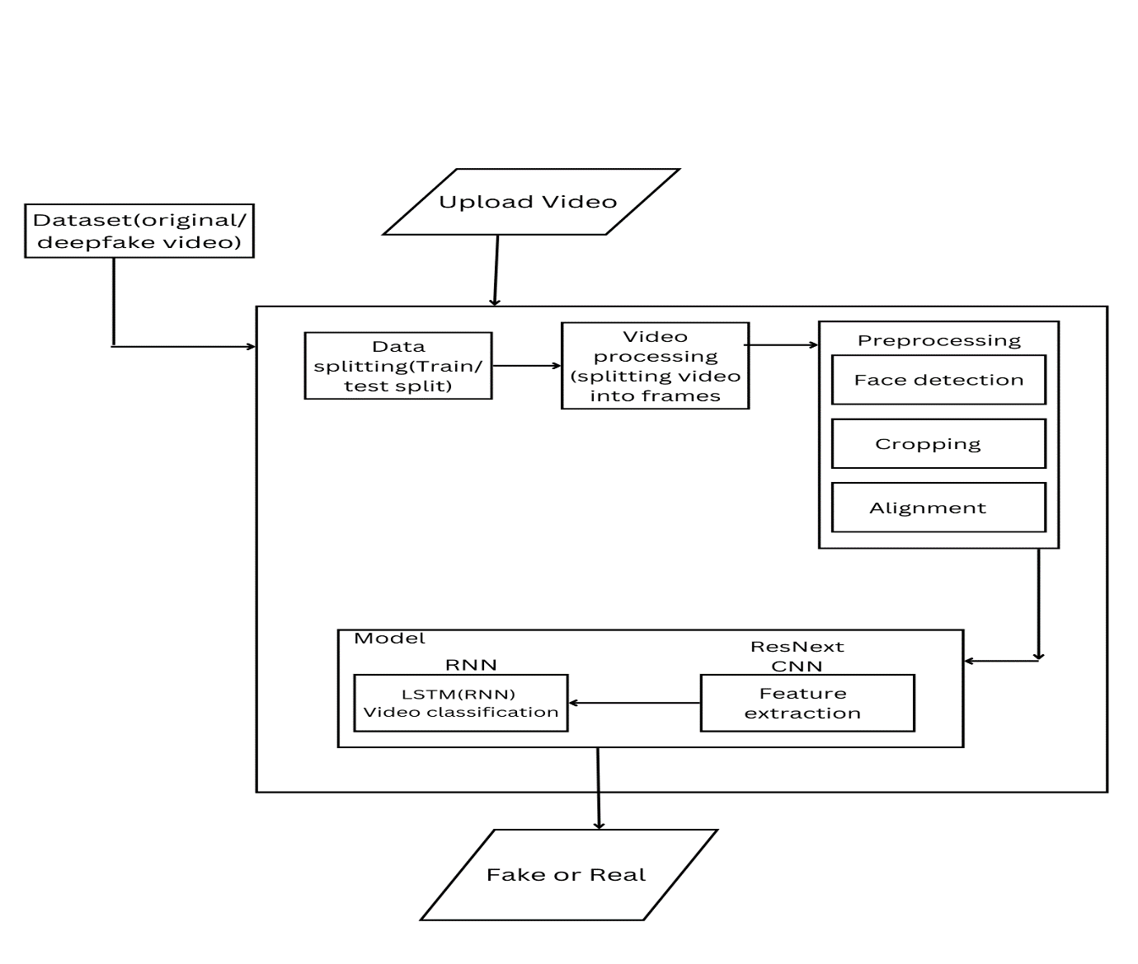
SYSTEM ARCHITECTURE

Slide 15
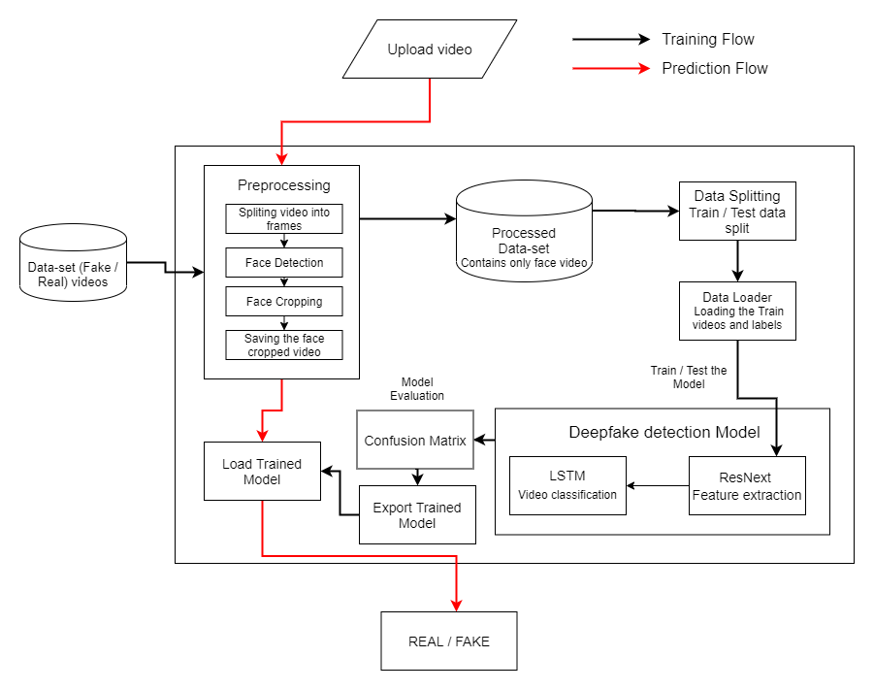

HIGH LEVEL DESIGN

Slide 16
TOOLS AND PLATFORM
1.Programming Languages: Python.
2.Libraries and Frameworks: TensorFlow, PyTorch, Keras, OpenCV, Scikit-learn.
3.Deepfake Detection Datasets: Celeb-DF provide labeled data for training and evaluating deepfake detection model.
4. Pretrained Models: ResNext, VGGNet, and EfficientNet pretrained on large-scale image .
5.Development Environment: google colab.
6.Hardware: GPUs (Graphics Processing Units) or TPUs (Tensor Processing Units) can significantly speed up the training process of deep learning models, especially for large datasets and complex architectures.
7.Model Evaluation Tools: Tools for evaluating the performance of deepfake detection models, such as confusion matrices, precision-recall curves, and metrics like accuracy, precision, recall, and F1 score.

Slide 17
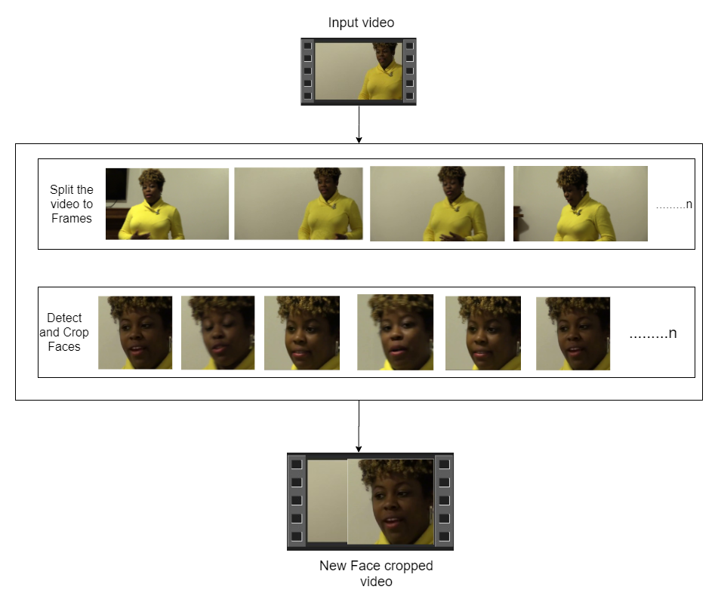

Implementation
Pre-processing
SPLIT VIDEO INTO FRAMES
FACE DETECTION
5
4
3
2
1
CROPING FACE
CREATING NEW FACE CROPPED VIDEO
SAVING THE FACE CROPPED VIDEO

Slide 18
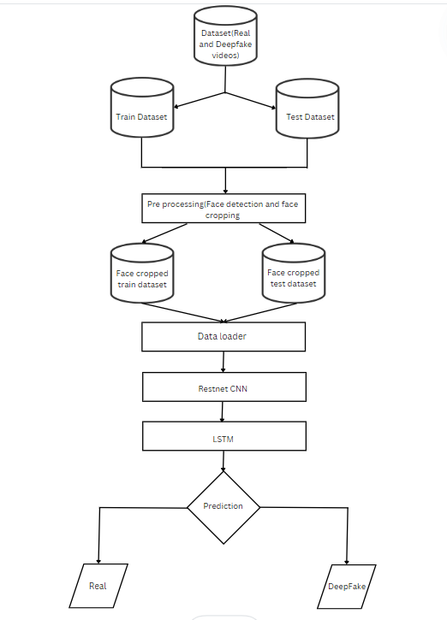
Training Workflow

Slide 19
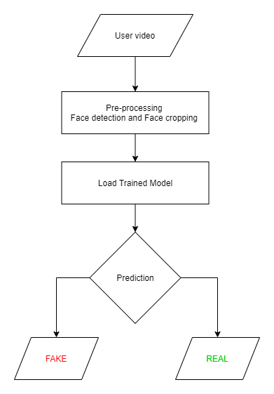
Prediction Workflow

Slide 20
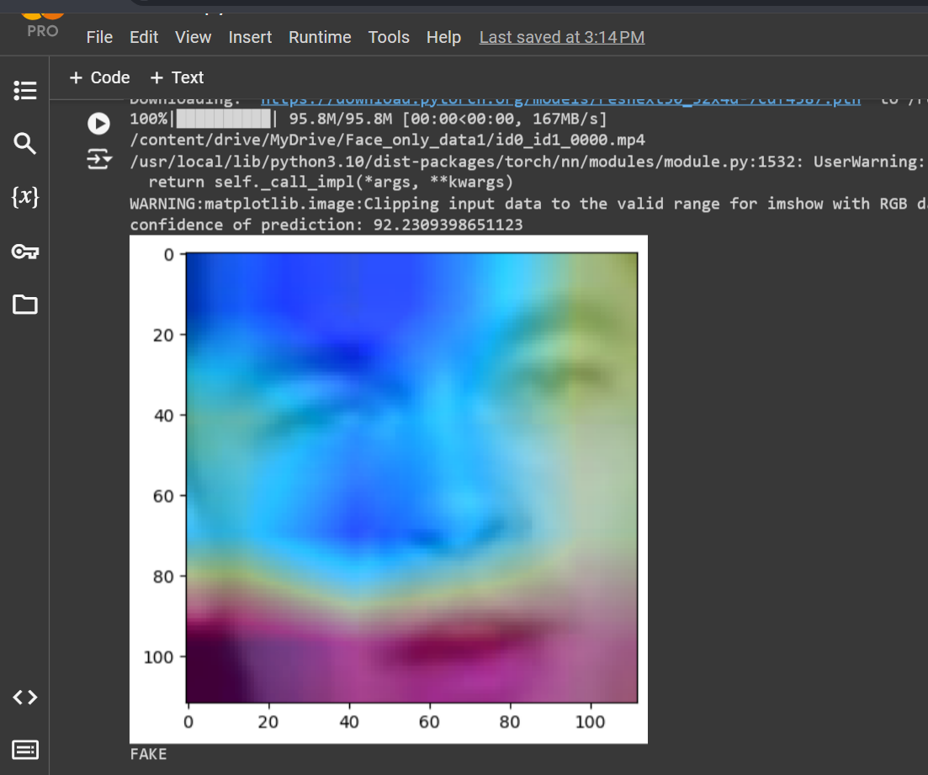
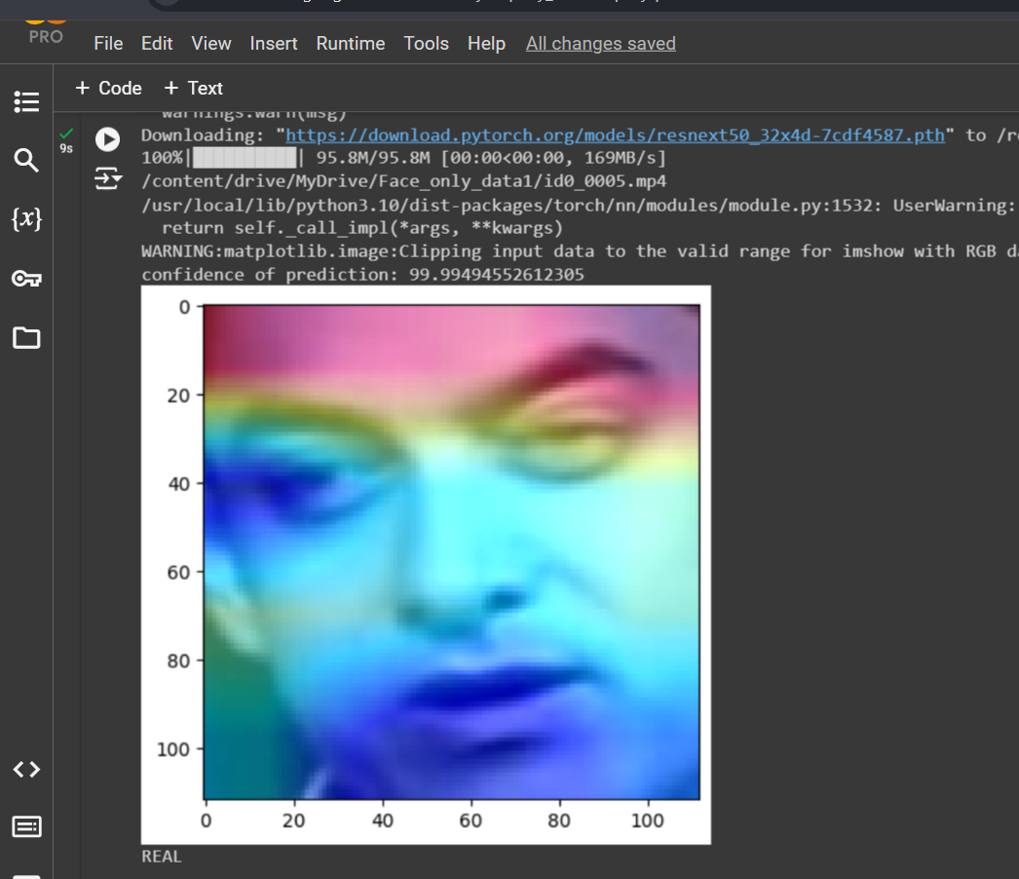
RESULTS
Dataset | No of videos | Sequence length | Accuracy
Celeb-DF-v2 | 1323 | 20 | 96.22641

Slide 21
CONCLUSION
Deepfake detection on social media platforms is crucial for preserving digital integrity and combating misinformation. Leveraging advanced AI techniques and deep learning models, such as CNNs trained on curated datasets, offers promising avenues for accurate detection. Continued research and collaboration are essential to stay ahead of evolving deepfake technologies and ensure a trustworthy online environment.

Slide 22
REFERENCES
1. Afchar, D., Nozick, V., Yamagishi, J., & Echizen, I. (2018). Mesonet: A compact facial video forgery detection network. Paper presented at the 2018 IEEE International Workshop on Information Forensics and Security (WIFS).
2. Ahmed, I., Ahmad, M., Rodrigues, J. J., & Jeon, G. (2021). Edge computing-based person detection system for top view surveillance: Using CenterNet with transfer learning. Applied Soft Computing, 107, 107489.
3. Y. Mirsky and W. Lee, The creation and detection of deep fakes: A survey, ACM Comput. Surv., vol. 54, no. 1, pp. 141, Jan. 2022.
4.M.Masood,M.Nawaz,K.M.Malik,A.Javed,andA.Irtaza, Deepfakes generation and detection: State-of-the-art, open challenges, countermea sures, and way forward, 2021, arXiv:2103.00484.
5. R. Tolosana, R. Vera-Rodriguez, J. Fierrez, A. Morales, and Deepfakes and beyond: A survey of face manipulation and detection, Inf. Fusion, vol. 64, pp. 131148, Dec. 2020.
6. An Overview of ResNet and its Variants : Vision and Pattern Recognition, pages 5967–5976, July 2017. Honolulu, HI.
7. R. Raghavendra, Kiran B. Raja, Sushma Venkatesh, and Christoph Busch, “Transferable deep-CNN features for detecting digital and print-scanned morphed face images,” in CVPRW. IEEE, 2017.
8.Tiago de Freitas Pereira, Andr´e Anjos, Jos´e Mario De Martino, and S´ebastien Marcel, “Can face anti spoofing countermeasures in a real world scenario?,”in ICB. IEEE, 2013.
(ICME). IEEE, 2020, pp. 1–6.47, no. 9, pp. 2825–2838, 2014.

